Slide 1
Database Fundamentals
Summer 2022 Cohort

Slide 2

Intro - Databases
SQL
NoSQL
RDBMS
SCHEMAS
KEYS
JOINS
OLAP & OLTP
Queries
Notes:
What the different terms mean and speak confidently about data.
One of the most crucial parts of data science and analysis.
It will also help when speaking to external or internal stakeholders. And when you eventually need to interview at companies yourself in the future.

Slide 3
What is a database?
Databases are systems which store and manage data, but there are a number of different types of database systems.
Different ways of physically storing the data – on disk and in memory.
As well as how systems retrieve the data and present it to the user.

Slide 4
Relational (SQL) vs Non-Relational (NoSQL)
Structured Query Language
Fixed Schema - the structure in and between the tables.
Relationship between tables
NoSQL – Not one single thing … different models.
Generally a much more relaxed schema.
Relationships handled differently.
Notes:
They are very broadly split into relation and non-relational.
Relational:
SQL is used – which is a language – but most people us the term SQL and RDBMS interchangeably. RDBMS stands for Relational Database management system. (click)
Relational
The relationship between the data is fixed and rigid. This is defined ahead of time by what is known as the schema. (click) Schema is the structure in and between the tables.
RDBMS has a rigid structure. It’s defined ahead of time. This is what companies used (and still do) for years.
No SQL as the name suggests is everything which doesn’t fit into the SQL mold. Everything that isn’t relational.
More relaxed concept of a schema. Relationships between tables. In general, they all have weaks schemas or none at all and relationships between tables are handled very differently.

Slide 5
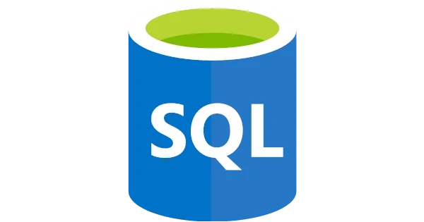
PART 1
Notes:
Start off with sql

Slide 6

RDBMS
The software used to store, manage, query, and retrieve data stored in a relational database is called a relational database management system (RDBMS).
The RDBMS provides an interface between users and applications and the database

Slide 7
Relational Data Example
Primary Key
C_ID | FirstName | LastName | Age
1 | Harry | Potter | 14
2 | Ginevra | Weasley | 12
3 | Rubeus | Hagrid | 55
4 | Ron | Weasley | 14
Table relationships and schemas defined in advanced.
Table relationships use keys.
C_ID | O_ID
1 | 1
2 | 2
4 | 2
Composite Key
O_ID | Name
1 | Hedwig
2 | Pigwidgeon
Notes:
Cover: Tables, keys (primary, composite and foreign) and relationships.
- The key component of any SQL database system is a table. - Columns, rows. Attributes and attribute values
- Give example with table on screen.
- Every row in the table has to be uniquely identifiable. We define something that’s known as a primary key. (click) give example
-Table 2. (click) It also has a primary key that has been defined – the O_ID. This primary key on this table also has to have a unique value in every row on the table.
So in this case, Hedwig is Owl ID 1 and Pigwidgeon is owl ID 2.
In an RDBMS, each table can have different values that it stores, or attributes. As SQL systems are relational, we generally define relationships between tables. (click)
This is a JOIN table, it makes it easy to have many-to-many relationships. So a character can have multiple pets and a pet can have multiple characters.
A join table has what is known as a composite key. (ANIMATION) Which is a key formed of two parts, when attached together must be unique. Notice how the second and fourth roles have the same Owl ID. That’s fine since each character is different, and together the they are unique. The composite key in its entirety is unique..
CRUCIAL: The keys in different tables are how the relationships between the tables are defined. (click)
So in this example the characters table has a relationship with the join table, it allows multiple animals to have multiple animals and each animal to have many characters.
All of these keys and relationships are defined in advance. (click) This is done in the schema, it’s fixed and it’s very difficult to change after the first piece of data goes in. The fact that this schema is so fixed and has to be declared in advance makes it difficult for SQL or raltional systems to store any data which has rapidly changing relationships.
A good example of this is a social network like Facebook or Insti. Relationships between people are changing all the time.
So this is a simple example of an RDBMS. It generally has multiple tables. It has fixed schemas, they have attributes, rows. Each row has a primary key and has to contain some value for all of the attributes in the tables.
What to remember:
What a schema is
What keys are and what there role is in the table.
Make sure to mention Foreign KEYS.
This is SQL and relational database modelling.

Slide 8
Quiz
Notes:
Broadly speaking, what are the two different types of databases? Relational and Non-Relational.
What’s a shema? The relationship in and between the tables.
What is a fixed schema? A schema that cannot be altered after it’s been declared.
What does RDBMS stand for and what does it define? interface between users and applications and the database
What is the difference between SQL and NoSQL? Relational vs Non-Relational databases, store and retrieve data differently and
What is a composite key? A combination of two or more columns in a table that can be used to uniquely identify each row in the table.
What is a foreign key? A Foreign Key is a database key that is used to link two tables together
What should you join two tables on? The keys or the most granular level of detail. Depends on the aggregation and data model you want.

Slide 9

Data modelling & query practice!
PART 3
SELECT * FROM journeys
WHERE where_to = “Mordor”
AND method = “simply walking in”
Returns: No results found
Notes:
So I’ve spoken a lot about databases, engines and different types of data and how they are all stored.
What is data modelling?
How to keep it in mind.
Understanding how to connect tables on the most granular level of detail.
Have you defined a schema and do you realise how this will change the aggregation in the view?
Simply things that you need to keep in mind when creating a dashboard or writing a query.
You’ll pick up these things naturally as your on the job – this is just to accelerate your learning

Slide 10
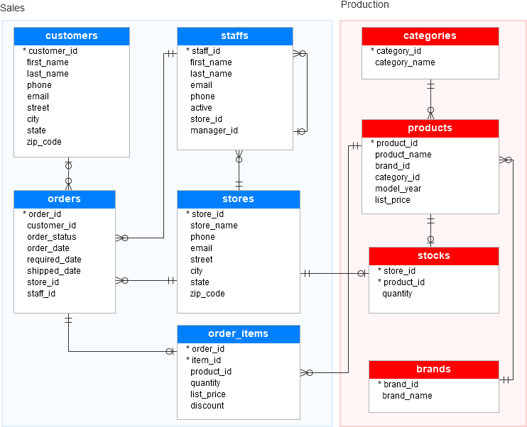
Entity Relationship Diagram
Notes:
Real life example of data model in Power BI. Quick example before end.
What is an ERD diagram? Entity relationship diagrams.

Slide 11
Most common types of queries
Select, From
Where clause
Aggregations: MAX, MIN, AVG, SUM
Order by
Group by
Having
Limit
JOINS
Inner join
Right join
Left join

Slide 12
Order of writing a query
Select
Top
Distinct
From
Where
Group by
Having
Order by
Limit

Slide 13
DateFunctions
CAST
DATETRUNC
DATEADD
DATEDIFF
date
day, month, quarter, year
today, weekday
Notes:
https://docs.microsoft.com/en-us/dax/date-and-time-functions-dax
SQL is an excellent tool to learn how datefunctions work. They are also the building block to understanding how the same functions work in BI tools. Understand date functions is key to understanding how to use a BI tool.

Slide 14
Showcase

Slide 15
Showcase
Create database
Create table
Insert into table
Create an ERD
Where clause – string, conditionals, null
Order by
Load .csv
Group by
Not in

Slide 16
PART 2
No
Notes:
With the exception of graph databases, non-relational databases have optimised for scalability, up-time, redundancy, flexibility and usually at the expense of queryability.
Not only SQL

Slide 17
Non Relational Databases
Key-Value databases
Wide Column Store
Document
OLTP and OLAP (Rows and Column stores)
Graph
Notes:
You don’t need to understand how they work – just what they are.

Slide 18
Key-Value databases
Key
Value
Number of steps done in a day
2022-06-22 10:00
2022-06-22 12:00
2022-06-22 16:00
2022-06-22 18:00
3 000
5 000
7 500
16 000
No Schema
No Structure
Scalable
Really Fast

Slide 19
Wide Column Store
Key
Table
KEY 1 | KEY 2
KEY 1 | KEY 2
KEY 1 | KEY 2
KEY 1 | KEY 2
NOTHING
No Attribute Schema
Other Key
Notes:
DynamoDB

Slide 20
OLTP – Row Store
MySQL
Row
Stored as Rows
Online Transaction Processing
ORDER ID
CARD No
PRICE
POSTCODE
Notes:
OLAP systems are designed for use by data scientists, business analysts and knowledge workers, and they support business intelligence (BI), data mining and other decision support applications.
OLTP, on the other hand, is optimized for processing a massive number of transactions. OLTP systems are designed for use by frontline workers (e.g., cashiers, bank tellers, hotel desk clerks) or for customer self-service applications (e.g., online banking, e-commerce, travel reservations).

Slide 21
OLAP - Column Store
Snowflake, Google Big Query, PostgreSQL, Redshift…
..used by data scientists, business analysts, research analysts etc.
and they support business intelligence (BI), data mining and other decision support applications.
Stands for Online
Notes:
These are all products that turn OLTP databases into something that is easy to analyse and use as a data scientist of analyst.
The cols are stored together and ideal for when you want to query a specific aggregation is required.
Online application Processing

Slide 22
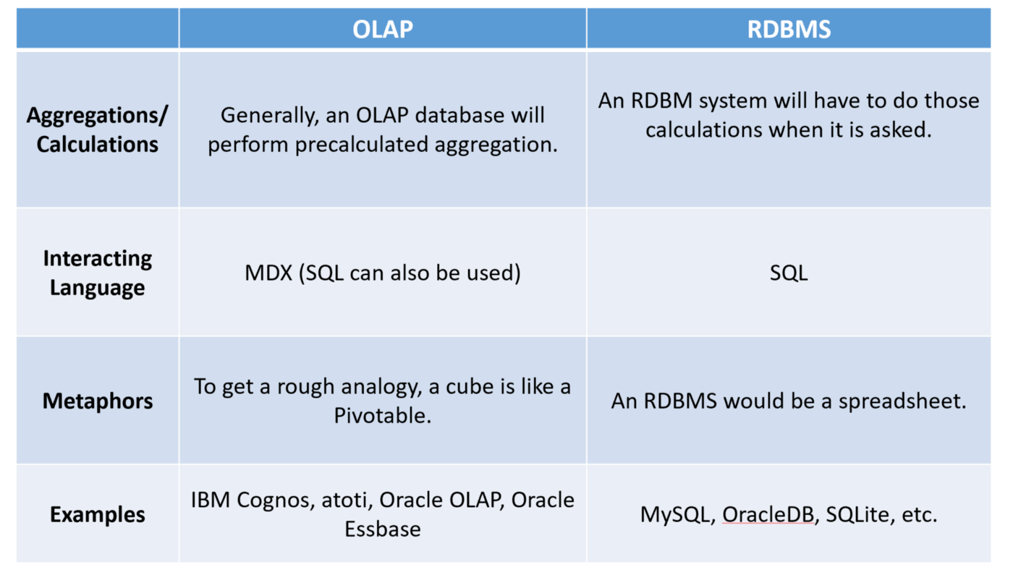
RDBMS vs OLAP

Slide 23
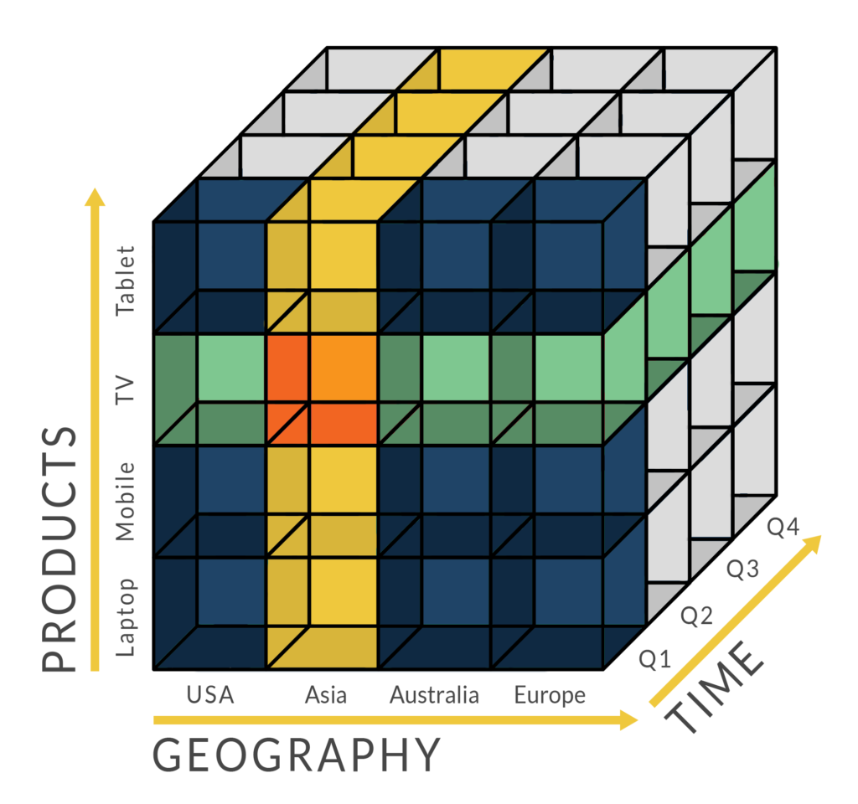
Notes:
OLAP is a design paradigm, a way to seek information out of the physical data store. OLAP is all about summation. It aggregates information from multiple systems, and stores it in a multi-dimensional format.

Slide 24
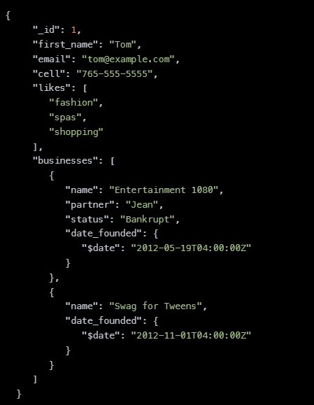
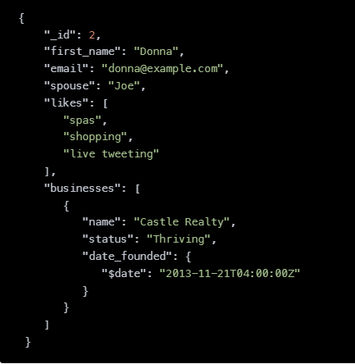
Document
Notes:
Mongo DB
Document stores, also called document-oriented database systems, are characterized by their schema-free organization of data. That means: Records do not need to have a uniform structure, i.e. different records may have different columns.

Slide 25
GraphQL
Person
comp
Person
comp
City
Person
Notes:
Graph QL.
A graph database stores nodes and relationships instead of tables, or documents. Data is stored just like you might sketch ideas on a whiteboard. Your data is stored without restricting it to a pre-defined model, allowing a very flexible way of thinking about and using it.

Slide 26
Quiz
Notes:
What type of database is a NoSQL database? Non-relational
Name 2 types of NoSQL databases.
What does OLAP stand for?
What type of structure does a key-value database have? None
Can you tell me where how you can find the schema to your database? Create an ERD or query this using the information_schema

Slide 27

Notes:
What defines a NoSQL database?
How do OLTP systems store data?
What does OLTP stand for?
Name one service that shifts OLTP data into OLAP so that it’s ready for analysis.
What type of structure does a key-value database have?
Can you tell me where how you can find the schema to your database?

Slide 28
Activity
Woo !
Notes:
Give the project B data.

Slide 29
Further Reading
https://www.simplilearn.com/tutorials/sql-tutorial/what-is-normalization-in-sql#:~:text=Normalization%20is%20the%20process%20to,data%20from%20the%20relational%20tables.
https://community.powerbi.com/t5/Community-Blog/Data-Modelling-In-Power-BI-Helpful-Tips-amp-Best-Practices/ba-p/1977956
https://www.sumologic.com/glossary/crud/#:~:text=CRUD%20Meaning%3A%20CRUD%20is%20an,%2C%20read%2C%20update%20and%20delete.
https://www.altexsoft.com/blog/business/comparing-database-management-systems-mysql-postgresql-mssql-server-mongodb-elasticsearch-and-others/
https://portswigger.net/web-security/sql-injection
https://statanalytica.com/blog/python-vs-sql/
https://www.analyticsvidhya.com/blog/2021/06/join-the-dataframes-like-sql-tables-in-python-using-pandas/
https://www.exoscale.com/syslog/nosql-query/
Notes:
Also get yourself comfortable with the terms granularity, level of detail and aggregation.
Focus on python, have SQL in your toolbox.

